Slide 1
Software Engineering (SE)
By Sandia Kumari
Software Testing
Lecture 2 & 3

Slide 2
V & V confidence
Aim of V & V is to establish confidence that the system is ‘fit for purpose’.
The level of confidence required depends on system’s purpose, user expectations and marketing environment
Software purpose
The level of confidence depends on how critical the software is to an organisation.
User expectations
Users may have low expectations of certain kinds of software.
Marketing environment
Getting a product to market early may be more important than finding defects in the program.

Slide 3
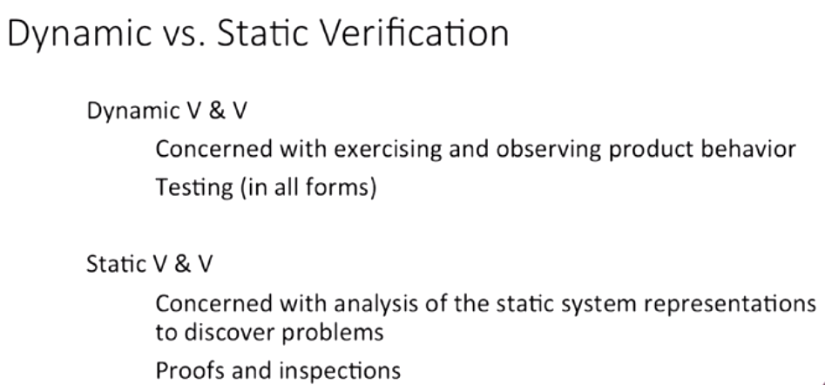

Slide 4
Static V & V

Slide 5
Advantages of inspections
During testing, errors can mask (hide) other errors. Because inspection is a static process, you don’t have to be concerned with interactions between errors.
Incomplete versions of a system can be inspected without additional costs. If a program is incomplete, then you need to develop specialized test harnesses to test the parts that are available.
As well as searching for program defects, an inspection can also consider broader quality attributes of a program, such as compliance with standards, portability and maintainability.

Slide 6
Inspections and testing
Inspections and testing are complementary and not opposing verification techniques.
Both should be used during the V & V process.
Inspections can check conformance with a specification but not conformance with the customer’s real requirements.
Inspections cannot check non-functional characteristics such as performance, usability, etc.

Slide 7
A model of the software testing process

Slide 8
Stages of testing
Commercial Software has to go through 3 stages
Development testing, where the system is tested during development to discover bugs and defects.
Release testing, where a separate testing team test a complete version of the system before it is released to users.
User testing, where users or potential users of a system test the system in their own environment.

Slide 9
Development testing
Development testing includes all testing activities that are carried out by the team developing the system.
Unit testing, where individual program units or object classes are tested. Unit testing should focus on testing the functionality of objects or methods.
Component testing, where several individual units are integrated to create composite components. Component testing should focus on testing component interfaces.
System testing, where some or all of the components in a system are integrated and the system is tested as a whole. System testing should focus on testing component interactions.

Slide 10
Unit testing
Unit testing is the process of testing individual components in isolation.
It is a defect testing process.
Units may be:
Individual functions or methods within an object
Object classes with several attributes and methods
Composite components with defined interfaces used to access their functionality.

Slide 11
Object class testing
Complete test coverage of a class involves
Testing all operations associated with an object
Setting and interrogating all object attributes
Exercising the object in all possible states.
Inheritance makes it more difficult to design object class tests as the information to be tested is not localised.

Slide 12

The weather station object interface

Slide 13
Weather station testing
Need to define test cases for reportWeather, calibrate, test, startup and shutdown.
Using a state model, identify sequences of state transitions to be tested and the event sequences to cause these transitions
For example:
Shutdown -> Running-> Shutdown
Configuring-> Running-> Testing -> Transmitting -> Running
Running-> Collecting-> Running-> Summarizing -> Transmitting -> Running

Slide 14
Automated testing
Whenever possible, unit testing should be automated so that tests are run and checked without manual intervention.
In automated unit testing, you make use of a test automation framework (such as JUnit) to write and run your program tests.
Unit testing frameworks provide generic test classes that you extend to create specific test cases. They can then run all of the tests that you have implemented and report, often through some GUI, on the success of otherwise of the tests.

Slide 15
Automated test components
An automated test has three parts:
A setup part, where you initialize the system with the test case, namely the inputs and expected outputs.
A call part, where you call the object or method to be tested.
An assertion part where you compare the result of the call with the expected result. If the assertion evaluates to true, the test has been successful if false, then it has failed.

Slide 16
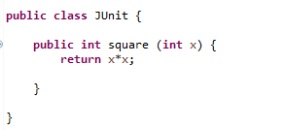
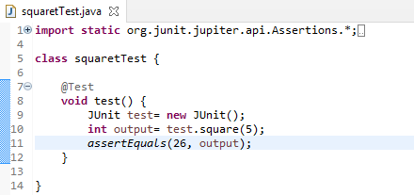
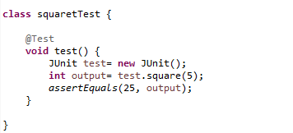
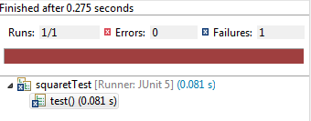
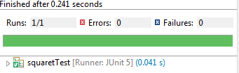
Function
Test Case 2
Test Case 1

Slide 17
Mock objects
Sometimes, the object that you are testing has dependencies on other objects that may not have been implemented or whose use slows down the testing process.
For example, if an object calls a database, this may involve a slow setup process before it can be used. In such cases, you may decide to use mock objects.
Mock objects are objects with the same interface as the external objects being used that simulate its functionality
Notes:
Mockito is a popular mock framework which can be used in conjunction with JUnit. Mockito allows you to create and configure mock objects

Slide 18
Choosing unit test cases
Testing is expensive and time consuming, so it is important that you choose effective unit test cases. Effectiveness, in this case, means two things:
The test cases should show that, when used as expected, the component that you are testing does what it is supposed to do.
If there are defects in the component, these should be revealed by test cases.

Slide 19
Designing unit test cases
This leads to 2 types of unit test case:
The first of these should reflect normal operation of a program and should show that the component works as expected.
The other kind of test case should be based on testing experience of where common problems arise. It should use abnormal inputs to check that these are properly processed and do not crash the component.

Slide 20
Testing strategies
Two strategies that can be effective in helping you choose test cases are:
Partition testing, where you identify groups of inputs that have common characteristics and should be processed in the same way.
You should choose tests from within each of these groups.
Guideline-based testing, where you use testing guidelines to choose test cases.
These guidelines reflect previous experience of the kinds of errors that programmers often make when developing components.

Slide 21
Partition testing
Input data and output results often fall into different classes where all members of a class are related.
Each of these classes is an equivalence partition or domain where the program behaves in an equivalent way for each class member.
Test cases should be chosen from each partition.

Slide 22
Equivalence Partitioning

Slide 23
Equivalence Partitions

Slide 24
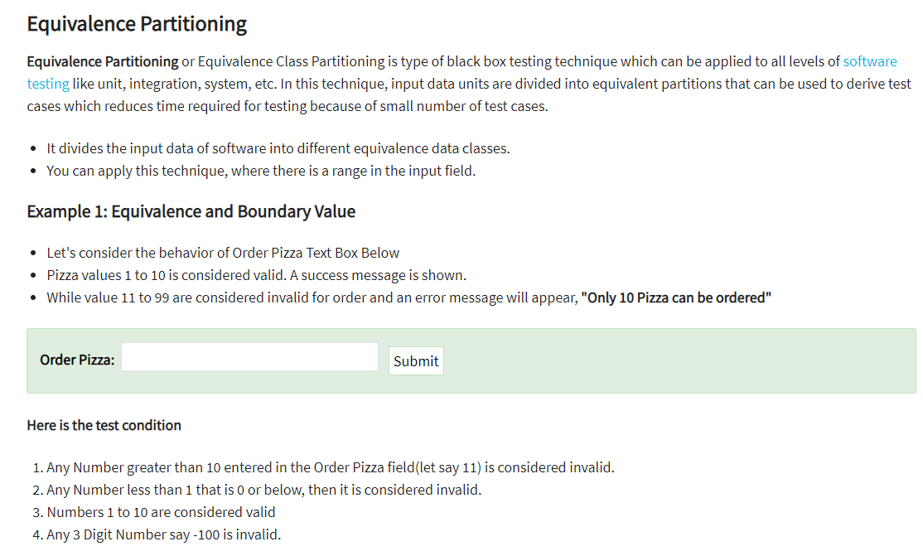
Notes:
https://www.guru99.com/equivalence-partitioning-boundary-value-analysis.html

Slide 25
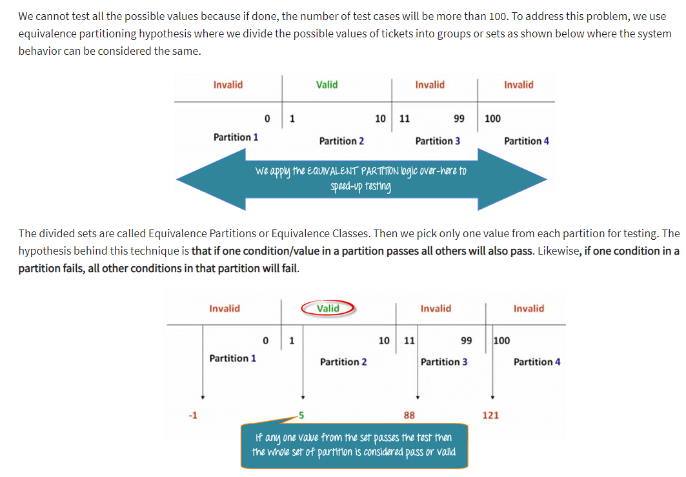

Slide 26
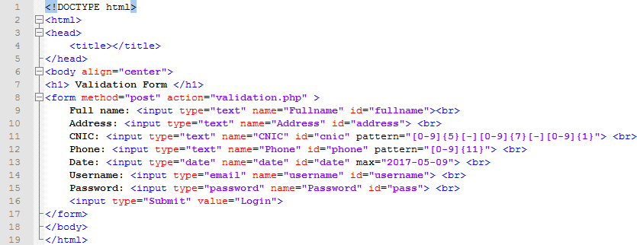
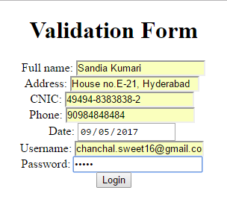

Slide 27
You can also use testing guidelines to help choose test cases. Guidelines encapsulate knowledge of what kinds of test cases are effective for discovering errors.
For example, when you are testing programs with sequences, arrays, or lists, guidelines that could help reveal defects include:

Slide 28
Testing guidelines (sequences)
Test software with sequences which have only a single value.
Use sequences of different sizes in different tests.
Derive tests so that the first, middle and last elements of the sequence are accessed.
Test with sequences of zero length.

Slide 29
General testing guidelines
Choose inputs that force the system to generate all error messages
Design inputs that cause input buffers to overflow
Repeat the same input or series of inputs numerous times
Force invalid outputs to be generated
Force computation results to be too large or too small.

